Slide 1

Defense Industrial Base (DIB) Sector Coordinating Council (SCC) Supply Chain Cyber Training
Cyber/Cybersecurity Maturity Model Certification (CMMC) v2.0

Slide 2
Agenda
Module 1: Cybersecurity: Why it is Important?
Module 2: Cybersecurity Maturity Model Certification
Module 3: Incident Reporting
Module 4: Cybersecurity Best Practices
Resource Guide: Glossary, Acronym Guide and Resources for Additional Information
CMMC Domains
Survey

Slide 3
Cybersecurity Maturity Model Certification (CMMC) Level 1
Module 2

Slide 4
Disclaimer and Overview
Note: CMMC is still going through the rule-making process and certain aspects and requirements may change. Refer to the Resources Guide provided in this training for the most updated information.
The intent of this training is to build awareness for Defense Industrial Base (DIB) suppliers of the likely requirements of the Cybersecurity Maturity Model Certification (CMMC) and their obligation to meet FAR 52.204-21 (basic cyber hygiene) and DFARS 252.204-7012 (specialized data handling and protection requirements).
This training is self-paced and intended for a range of roles and responsibilities including, but not limited to, executives, project managers and technical staff from organizations seeking certification (OSC) and need to comply with CMMC. Currently, CMMC does not apply to any contractor.
Note: Completion of this training DOES NOT certify your organization. This training is intended for the purposes of providing awareness of the subjects outlined above.
The DIB Sector Coordinating Council (SCC) Supply Chain Task Force does not take responsibility for suppliers’ certification by the CMMC 3rd Party Assessment Organization (C3PAO).
This training focuses on U.S. regulations and industry best practices:
U.S. Department of Defense (DoD) Chief Information Officer (CIO) Cybersecurity Maturity Model Certification (CMMC) Information
National Institute of Standards & Technologies (NIST) publications
National Archives & Records Administration (NARA) definitions
DIB SCC Supply Chain Task Force – CyberAssist website

Slide 5
Module Topics and Objectives
Helpful Hint:
Refer to the Resource Guide for a Glossary and Acronym Guide
Topics covered in this module:
Cybersecurity Maturity Model Certification (CMMC)
Protecting U.S. Government Information: FCI and CUI
CMMC Domains, CMMC Enumeration/Numbering Defined and Self-Assessment process
How to Prepare for CMMC
The objectives of this module are:
Provide understanding of the CMMC model;
Provide understanding of FCI and CUI;
Provide understanding of the self-assessment process; and
Provide guidance on how to prepare for CMMC.
A legend has been provided to assist with determining the content that you will need to know for each of the CMMC levels and what is additional content that will assist your organization with your cybersecurity posture. The corresponding symbol will be located at the top left corner of the slide.
Content Legend
= CMMC L1 Content
= CMMC L2 Content
= CMMC L3 Content
= Non-CMMC Content/Extra

Slide 6
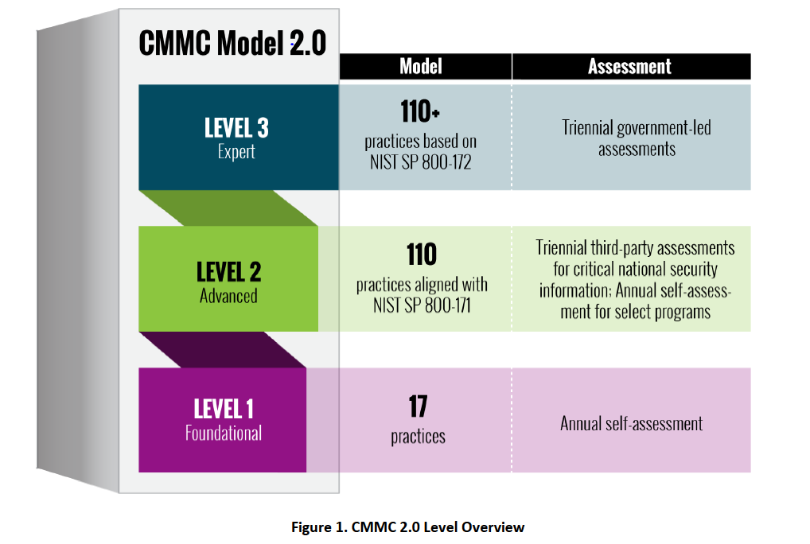
Cybersecurity Maturity Model Certification (CMMC)
CMMC was created by the DoD in response to rising malicious cyber activity impacting Department of Defense (DoD) systems and data.
CMMC measures the implementation of cybersecurity requirements at three levels.
CMMC Model 2.0 combines various cybersecurity standards and best practices and is built on NIST 800-171 and a sub-set of NIST 800-172.
Source: Cybersecurity Maturity Model Certification Model Overview Version 2.0 | December 2021, https://dodcio.defense.gov/Portals/0/Documents/CMMC/ModelOverview_V2.0_FINAL2_20211202_508.pdf
Notes:
The CMMC model measures the implementation of cybersecurity requirements at three levels. Each level consists of a set of CMMC practices:
Level 1 (Foundational): Encompasses the basic safeguarding requirements for Federal Contract Information (FCI) specified in FAR Clause 52.204-21.
Level 2 (Advanced): Encompasses the security requirements for Controlled Unclassified Information (CUI) specified in NIST SP 800-171 Rev 2 per DFARS Clause 252.204-7012.
Level 3 (Expert): Information on Level 3 will be released at a later date and will contain a subset of the security requirements specified in NIST SP 800-172.
Source: Cybersecurity Maturity Model Certification Model Overview Version 2.0 | December 2021
CMMC is intended to be cost-effective and affordable for small businesses to implement at the lower CMMC levels.
CMMC includes 14 domains (key sets of cybersecurity capabilities).
All contractors and suppliers doing business with DoD must meet the CMMC Level 1 requirements at a minimum.
The CMMC level of certification required for each DoD procurement will be specified in Request for Information (RFIs) and Request for Proposals (RFPs)
Contractors will need to flow down appropriate CMMC Level requirements and verify supplier certification levels (CMMC Level 1 for FCI but no CUI; CMMC Level 2 or above for CUI).
Recommendation: Reference the CyberAssist site, https://ndisac.org/dibscc/cyberassist/cybersecurity-maturity-model-certification/, periodically for updated CMMC information and resources.

Slide 7
Protecting U.S. Government Information: FCI
What is FCI?
FCI is any U.S. Government information that is “not intended for public release” that is provided by or generated for the U.S. Government
Key Regulation?
FAR 52.204-21: Basic Safeguarding of Covered Contractor Information Systems
Key Documents?
None, 15 FAR controls map to 17 National Institute of Standards and Technology (NIST) Special Publication (SP) 800-171 controls
CMMC Self-Assessment Guide - Level 1
Notes:
Federal Contract Information (FCI) is information, not intended for public release, that is provided by or generated for the Government under a contract to develop or deliver a product or service to the Government, but not including information provided by the Government to the public (such as on public websites) or simple transactional information, such as necessary to process payments. (FAR 52.204-21)
FAR 52.204-21: Basic Safeguarding of Covered Contractor Information Systems requires the basic safeguarding requirements and procedures to protect covered contractor information systems
2016 Implementation
No Grace Period for Compliance
15 Controls (17 NIST/CMMC practices)
Considered Minimum Compliance Criteria
“Covered contractor information system” means an information system that is owned or operated by a contractor that processes, stores, or transmits FCI.
Note: An update is expected to this clause that could change the content.

Slide 8
Protecting U.S. Government Information: CUI
What is CUI?
CUI is Information that requires safeguarding or dissemination controls pursuant to and consistent with law, regulations, and government-wide policies, excluding information that is classified under Executive Order 13526, Classified National Security Information, December 29, 2009, or any predecessor or successor order, or the Atomic Energy Act of 1954, as amended. Source: E.O. 13556 (adapted)
Key Regulation?
DFARS 252.204-7012: Safeguarding Covered Defense Information (CDI) and Cyber Incident Reporting
Key Documents?
NIST SP 800-171 and NIST SP 800-171A
NIST SP 800-172 and NIST SP 800-172A (CMMC Level 3)
CMMC Assessment Guide - Level 2
For more information on the CUI categories, refer to the CUI Registry, http://www.archives.gov/cui/registry/category-list.html
Note: This clause does not apply to contractors where it has been determined that CUI is not managed in the contractor's environment
Notes:
Controlled Unclassified Information (CUI) is information that law, regulation, or government wide policy requires to have safeguarding or disseminating controls, excluding information that is classified under Executive Order 13526, Classified National Security Information, December 29, 2009, or any predecessor or successor order, or the Atomic Energy Act of 1954, as amended.
Executive Order 13556 "Controlled Unclassified Information" (the Order), establishes a program for managing CUI across the Executive branch and designates the National Archives and Records Administration (NARA) as Executive Agent to implement the Order and oversee agency actions to ensure compliance. The Archivist of the United States delegated these responsibilities to the Information Security Oversight Office (ISOO).
32 CFR Part 2002 "Controlled Unclassified Information" was issued by ISOO to establish policy for agencies on designating, safeguarding, disseminating, marking, decontrolling, and disposing of CUI, self inspection and oversight requirements, and other facets of the Program. The rule affects Federal executive branch agencies that handle CUI and all organizations (sources) that handle, possess, use, share, or receive CUI— or which operate, use, or have access to Federal information and information systems on behalf of an agency.
DFARS 252.204-7012: Safeguarding Covered Defense Information (CDI) and Cyber Incident Reporting requires contractors who handle CDI on non-federal systems in performance of contracts to implement adequate cybersecurity safeguarding controls (NIST SP 800-171), rapidly report cyber incidents to the federal government within 72 hours of discovery, and to flow these requirements to their subcontractors who receive or generate CDI on their internal system.
DFARS 252.204-7012 invokes the NIST Special Publication 800-171 standard also known as “Protecting Controlled Unclassified Information in Nonfederal Information Systems and Organizations.”
In total, 800-171 has 110 unique security requirements that are split among 14 broader sections, or “families.”
Considering the volume and specificity of these requirements, any organization performing under contracts (or subcontracts) with the Defense Department must make sure that they have the requisite information security knowledge, expertise and resources to comply with NIST SP 800-171. Non-compliance, after all, could spell the end of a contractor’s relationship with the DoD.
Department of Defense Controlled Unclassified Information (DoD CUI) previously known as Covered Defense Information (CDI) is one example of CUI. In explaining what steps must be taken to protect CUI, the NIST guidelines cover the protection of DoD CUI or CDI as mandated by the DFARS clause 252.204-7012
For more information on the CUI categories, refer to the CUI Registry, http://www.archives.gov/cui/registry/category-list.html
What are the Safeguarding Requirements of DFARS 252.204-7012?
The DFARS 252.204-7012 essentially asks contractors “where is the Covered Defense Information (CDI)?” and instructs them to confirm that CDI is being protected in accordance with the security controls set forth in the NIST SP 800-171 standard.
Identify where CDI resides (either on the contractor’s IT systems or within the supply chain).
Validate CDI is protected per DFARS 252.204-7012 / NIST SP 800-171 controls.
Mitigate issues as needed and continuously monitor the contract for additional assets and suppliers that manage CDI.
System Security Plan (SSP): The formal document prepared by the information system owner (or common security controls owner for inherited controls) that provides an overview of the security requirements for the system and describes the security controls in place or planned for meeting those requirements. The plan can also contain as supporting appendices or as references, other key security-related documents such as a risk assessment, privacy impact assessment, system interconnection agreements, contingency plan, security configurations, configuration management plan, and incident response plan. Source: CNSSI 4009
Plan of Action and Milestones (POAM): A document that identifies tasks needing to be accomplished. It details resources required to accomplish the elements of the plan, any milestones in meeting the tasks, and scheduled completion dates for the milestones. NIST SP 800-53A Rev 4
Department of Defense Controlled Unclassified Information (DoD CUI) or Covered Defense Information
(CDI) is used to describe information that requires protection under DFARS Clause 252.204-7012. It is defined as unclassified controlled technical information (CTI) or other information as described in the CUI Registry that requires safeguarding/dissemination controls AND IS EITHER marked or otherwise identified in the contract and provided to the contractor by DoD in support of performance of the contract; OR collected/developed/received/transmitted/used/stored by the contractor in performance of contract.
“Technical information” means technical data or computer software, as those terms are defined in the clause at DFARS 252.227-7013, Rights in Technical Data-Non-Commercial Items, regardless of whether or not the clause is incorporated in this solicitation or contract. Examples of technical information include research and engineering data, engineering drawings, and associated lists, specifications, standards, process sheets, manuals, technical reports, technical orders, catalog item identifications, data sets, studies and analyses and related information, and computer software executable code and source code.
Primes should mark DoD CUI or CDI provided to suppliers or note expected DoD CUI or CDI to be developed in the contractual documents but be sure to specifically ask your prime anyway.
Note: Old contracts may have the reference CDI, where current or future contracts may have the reference DoD CUI. The U.S. Government is in the process for transitioning the terminology.

Slide 9
The CMMC Model
Domains, Practices and Self-Assessment Process

Slide 10
CMMC Domains
CMMC Domains (14)
Access Control (AC)
Audit and Accountability (AU)
Awareness and Training (AT)
Configuration Management (CM)
Identification and Authentication (IA)
Incident Response (IR)
Maintenance (MA)
Media Protection (MP)
Personnel Security (PS)
Physical Protection (PE)
Risk Assessment (RA)
Security Assessment (CA)
System and Communications Protections (SC)
System and Information Integrity (SI)
Legend:
Green cells: Includes CMMC L1 practices
Gray cells: Includes CMMC L2 or higher practices
Note: The 6 CMMC domains highlighted in green are discussed in the following slides. For more information on the remaining 8 CMMC domains, refer to the Supporting Material section at the end of the training.
Notes:
Each domain links out to the domain information on the DIB SCC Cyber Assist site, https://ndisac.org/dibscc/cyberassist/cybersecurity-maturity-model-certification/. The Cyber Assist site is a resource for suppliers to obtain more information on CMMC and other cybersecurity resources.
There are six (6) domains that include CMMC Level 1 practices.
Note: The 6 CMMC domains highlighted in green are address in the following slides. For more information on the remaining 11 CMMC domains, refer to the CMMC Domains module in this training.
When you click on one of the domains in the “CMMC Domains (14)” chart, you will be directed to the listing of all practices for that domain. From there, you can narrow it down by level.
Click on the domain in each box or the direct link listed below.
Access Control (AC): https://ndisac.org/dibscc/cyberassist/cybersecurity-maturity-model-certification/access-control/
Audit and Accountability (AU): https://ndisac.org/dibscc/cyberassist/cybersecurity-maturity-model-certification/audit-and-accountability/
Awareness and Training (AT): https://ndisac.org/dibscc/cyberassist/cybersecurity-maturity-model-certification/awareness-and-training/
Configuration Management (CM): https://ndisac.org/dibscc/cyberassist/cybersecurity-maturity-model-certification/configuration-management/
Identification and Authentication (IA): https://ndisac.org/dibscc/cyberassist/cybersecurity-maturity-model-certification/identification-and-authentication/
Incident Response (IR): https://ndisac.org/dibscc/cyberassist/cybersecurity-maturity-model-certification/incident-response/
Maintenance (MA): https://ndisac.org/dibscc/cyberassist/cybersecurity-maturity-model-certification/maintenance/
Media Protection (MP): https://ndisac.org/dibscc/cyberassist/cybersecurity-maturity-model-certification/media-protection/
Personnel Security (PS): https://ndisac.org/dibscc/cyberassist/cybersecurity-maturity-model-certification/personnel-security/
Physical Protection (PE): https://ndisac.org/dibscc/cyberassist/cybersecurity-maturity-model-certification/physical-protection-2/
Risk Assessment (RA): https://ndisac.org/dibscc/cyberassist/cybersecurity-maturity-model-certification/risk-management/
Security Assessment (CA): https://ndisac.org/dibscc/cyberassist/cybersecurity-maturity-model-certification/security-assessment/
Systems and Communications Protection (SC): https://ndisac.org/dibscc/cyberassist/cybersecurity-maturity-model-certification/system-and-communications-protection/
System and Information Integrity (SI): https://ndisac.org/dibscc/cyberassist/cybersecurity-maturity-model-certification/system-and-information-integrity/

Slide 11
Access Control (AC)
Access control is the process of granting or denying requests to use information, to use information processing services and/or enter company facilities. System-based access controls are called logical access controls, who or what (in the case of a process) is permitted to have access to a system resource and type of access permitted.*
Do you securely log into your company systems?
Does your company limit system access to types of transactions and functions?
Does your company restrict access to company facilities?
What is sensitive information?
Do you know how to handle and protect sensitive information?
*https://www.acq.osd.mil/asda/dpc/cp/cyber/docs/safeguarding/DoD-Guidance-for-Reviewing-System-Security-Plans-and-the-NIST-SP-800-11-6-2018.pdf
Notes:
Description: Access is the ability to make use of any system resource. Access control is the process of granting or denying requests to: use information; use information processing services; and enter company facilities. System-based access controls are called logical access controls. Logical access controls prescribe not only who or what (in the case of a process) is permitted to have access to a system resource, but also the type of access that is permitted. Controlling physical access to company facilities is also important. It provides for the protection of employees, plant equipment, hardware, software, networks, and data from physical actions and events that could cause serious loss or damage to the company.
CMMC Access Control (AC) practices can be located here: https://ndisac.org/dibscc/cyberassist/cybersecurity-maturity-model-certification/access-control/
CMMC Level 2 practices can be located here: https://ndisac.org/dibscc/cyberassist/cybersecurity-maturity-model-certification/level-2/
Questions for your company to assist with understanding the CMMC practices:
What types of access is permitted to your company’s information systems?
How do control and manage connections between your company’s network and outside networks?
Does your company control and limit access of personal devices, e.g., laptops, phones, to your company’s network?
How does your company ensure access to sensitive information, e.g., Federal Contract Information (FCI), is protected?
Does your company control information posted and processed on publicly accessible systems, e.g. your company’s website? Does your company limit and know what users are allowed to publish information on publicly accessible systems?

Slide 12
Identification and Authentication (IA)
Identification and authentication is a technical measure that prevents unauthorized individuals or processes from entering a system. Identification and authentication is a critical building block of information security since it is the basis for most types of access control and for establishing user accountability.*
How do users log into your systems?
Does everyone have full administrative rights on all systems?
Do you use any type of multifactor authentication (MFA)?
Do you have any password requirements setup?
Do you have a process for removing user accounts when an individual leaves the company?
*https://www.acq.osd.mil/asda/dpc/cp/cyber/docs/safeguarding/DoD-Guidance-for-Reviewing-System-Security-Plans-and-the-NIST-SP-800-11-6-2018.pdf
Notes:
Description: For most systems, identification and authentication is often the first line of defense. Identification is the means of verifying the identity of a user, process, or device, typically as a prerequisite for granting access to resources in a system. Identification and authentication is a technical measure that prevents unauthorized individuals or processes from entering a system. Identification and authentication is a critical building block of information security since it is the basis for most types of access control and for establishing user accountability. Access control often requires that the system can identify and differentiate between users. Companies should identify system users, processes acting on behalf of users, or devices and authenticate or verify the identities of those users, processes, or devices, as a prerequisite to allowing access to company systems.
CMMC Identification and Authentication (IA) practices can be located here: https://ndisac.org/dibscc/cyberassist/cybersecurity-maturity-model-certification/identification-and-authentication/
CMMC Level 2 practices can be located here: https://ndisac.org/dibscc/cyberassist/cybersecurity-maturity-model-certification/level-2/
Questions for your company to assist with understanding the practices:
How do users log into your systems?
Does everyone have full administrative rights on all systems?
Do you use any type of multifactor authentication (MFA)?
Do you have any password requirements setup?
Do you have a process for removing user accounts when an individual leaves the company?

Slide 13
Media Protection (MP)
Media protection is a requirement that addresses the defense of system media, which can be described as both digital and nondigital. Media protections can restrict access and make media available to authorized personnel only, apply security labels to sensitive information, and provide instructions on how to remove information from media so that the information cannot be retrieved or reconstructed.*
Do you sanitize systems before sending for disposal?
Do you protect backups at off-site facilities?
Do you protect your systems from removable media especially when coming from an unknown source?
*https://www.acq.osd.mil/asda/dpc/cp/cyber/docs/safeguarding/DoD-Guidance-for-Reviewing-System-Security-Plans-and-the-NIST-SP-800-11-6-2018.pdf
Notes:
Description: Media protection is a requirement that addresses the defense of system media, which can be described as both digital and nondigital. Media protections can restrict access and make media available to authorized personnel only, apply security labels to sensitive information, and provide instructions on how to remove information from media so that the information cannot be retrieved or reconstructed. Media protections also include physically controlling system media and ensuring accountability, as well as restricting mobile devices capable of storing and carrying information into or outside of restricted areas. Companies should protect system media, both paper and digital, limit access to information on system media to authorized users, and sanitize or destroy system media before disposal or release for reuse.
CMMC Media Protection (MP) practices can be located here: https://ndisac.org/dibscc/cyberassist/cybersecurity-maturity-model-certification/media-protection/
CMMC Level 2 practices can be located here: https://ndisac.org/dibscc/cyberassist/cybersecurity-maturity-model-certification/level-2/
Questions for your company to assist with understanding the CMMC practices:
Do you sanitize systems before sending for disposal?
Do you protect backups at off-site facilities?
Do you protect your systems from removable media especially when coming from an unknown source?

Slide 14
Physical Protection (PE)
The term physical (and environmental) security refers to measures taken to protect systems, buildings, and related supporting infrastructure against threats associated with their physical environment.*
Do you track and monitor visitors?
Is physical access to systems limited?
Do you take security measures when working offsite?
*https://www.acq.osd.mil/asda/dpc/cp/cyber/docs/safeguarding/DoD-Guidance-for-Reviewing-System-Security-Plans-and-the-NIST-SP-800-11-6-2018.pdf
Notes:
Description: The term physical (and environmental) security refers to measures taken to protect systems, buildings, and related supporting infrastructure against threats associated with their physical environment. Companies should limit physical access to systems, equipment, and the respective operating environments to authorized individuals, protect the physical plant and support infrastructure for systems, provide supporting utilities for systems, protect systems against environmental hazards, and provide appropriate environmental controls in facilities containing systems.
CMMC Physical Protection (PE) Practices can be located here: https://ndisac.org/dibscc/cyberassist/cybersecurity-maturity-model-certification/physical-protection-2/
CMMC Level 2 practices can be located here: https://ndisac.org/dibscc/cyberassist/cybersecurity-maturity-model-certification/level-2/
Questions for your company to assist with understanding the CMMC practices:
Do you track and monitor visitors?
Is physical access to systems limited?
Do you take security measures when working offsite?

Slide 15
System and Communications Protection (SC)
System and communications protection requirements provide an array of safeguards for the system, including the confidentiality information at rest and in transit. System and communications protection also establishes boundaries that restrict access to publicly accessible information within a system. Using boundary protections, a company can monitor and control communications at external boundaries as well as key internal boundaries within the system.*
Do you have firewalls and other segregation on your network?
Do you segregate public-facing systems from internal only systems?
Do you use encryption when transmitting over the Internet?
Do you limit the ability to connect to systems from outside the company?
*https://www.acq.osd.mil/asda/dpc/cp/cyber/docs/safeguarding/DoD-Guidance-for-Reviewing-System-Security-Plans-and-the-NIST-SP-800-11-6-2018.pdf
Notes:
Description: System and communications protection requirements provide an array of safeguards for the system. Some of the requirements in this family address the confidentiality information at rest and in transit. The protection of confidentiality can be provided by these requirements through physical or logical means. Companies can better safeguard their information by separating user functionality and system management functionality. Providing this type of protection prevents the presentation of system management-related functionality on an interface for non-privileged users. System and communications protection also establishes boundaries that restrict access to publicly accessible information within a system. Using boundary protections, a company can monitor and control communications at external boundaries as well as key internal boundaries within the system.
CMMC System and Communications Protection (SC) practices can be located here:
https://ndisac.org/dibscc/cyberassist/cybersecurity-maturity-model-certification/system-and-communications-protection/
CMMC Level 2 practices can be located here: https://ndisac.org/dibscc/cyberassist/cybersecurity-maturity-model-certification/level-2/
Questions for your company to assist with understanding the CMMC practices:
Do you have firewalls and other segregation on your network?
Do you segregate public-facing systems from internal only systems?
Do you use encryption when transmitting over the Internet?
Do you limit the ability to connect to systems from outside the company?

Slide 16
System and Information Integrity (SI)
System and information integrity provides assurance that the information being accessed has not been meddled with or damaged by an error in the system.*
Do you use Anti-malware/Anti-virus software and keep it updated?
Do you monitor for system vulnerabilities and/or malicious attacks?
*https://www.acq.osd.mil/asda/dpc/cp/cyber/docs/safeguarding/DoD-Guidance-for-Reviewing-System-Security-Plans-and-the-NIST-SP-800-11-6-2018.pdf
Notes:
Description: Integrity is defined as guarding against improper information modification or destruction, and includes ensuring information non-repudiation and authenticity. It is the assertion that data can only be accessed or modified by the authorized employees. System and information integrity provides assurance that the information being accessed has not been meddled with or damaged by an error in the system. Companies should identify, report, and correct information and system flaws in a timely manner, provide protection from malicious code at appropriate locations within company systems, and monitor system security alerts and advisories and respond appropriately.
CMMC System and Information Integrity (SI) practices can be located here:
https://ndisac.org/dibscc/cyberassist/cybersecurity-maturity-model-certification/system-and-information-integrity/
CMMC Level 2 practices can be located here: https://ndisac.org/dibscc/cyberassist/cybersecurity-maturity-model-certification/level-2/
Questions for your company to assist with understanding the CMMC practices:
Do you use Anti-malware/Anti-virus software and keep it updated?
Do you monitor for system vulnerabilities and/or malicious attacks?

Slide 17
CMMC Enumeration/Numbering Defined
Each practice is specified using the convention of DD.L#-REQ where:
DD is the two-letter domain abbreviation;
L# is the level number; and
REQ is the NIST SP 800-171 Rev 2 or NIST SP 800-172 security requirement number.
Example of the breakdown of a CMMC practice:
AC
L1
-
3.1.1
.
Description: Limit information system access to authorized users, processes acting on behalf of authorized users, or devices (including other information systems).
Source: Cybersecurity Maturity Model Certification Model Overview Version 2.0 | December 2021, https://dodcio.defense.gov/Portals/0/Documents/CMMC/ModelOverview_V2.0_FINAL2_20211202_508.pdf
Notes:
Each practice is specified using the convention of DD.L#-REQ where:
DD is the two letter domain abbreviation;
L# is the level number; and
REQ is the NIST SP 800-171 Rev 2 or NIST SP 800-172 security requirement number
Source: Cybersecurity Maturity Model Certification Model Overview Version 2.0 | December 2021
Level 1: 17 Practices, https://ndisac.org/dibscc/cyberassist/cybersecurity-maturity-model-certification/level-1/
Level 2: 110 Practices, https://ndisac.org/dibscc/cyberassist/cybersecurity-maturity-model-certification/level-2/

Slide 18
Identify Self-Assessment Scope
Prior to conducting self-assessment, the scope needs to be identified, CMMC Self-Assessment Scope – Level 1 Guide
FCI Assets are part of the CMMC Self Assessment Scope and are assessed against applicable CMMC practices.
Process - FCI can be used by an asset
Store - FCI is inactive or at rest
Transmit - FCI is being transferred from one asset to another asset
Consider people, technology, facilities and external service provider (ESP) within the environment that process, store and transmit FCI
Source: Cybersecurity Maturity Model Certification Model Overview Version 2.0 | December 2021, https://dodcio.defense.gov/Portals/0/Documents/CMMC/Scope_Level1_V2.0_FINAL_20211202_508.pdf
Notes:
CMMC Self-Assessment Scope – Level 1 Guide, https://dodcio.defense.gov/Portals/0/Documents/CMMC/Scope_Level1_V2.0_FINAL_20211202_508.pdf
FCI Assets:
Process - FCI can be used by an asset (e.g., accessed, entered, edited, generated, manipulated, or printed).
Store - FCI is inactive or at rest (e.g., located on electronic media, in system component memory, or in physical format such as paper documents).
Transmit - FCI is being transferred from one asset to another asset (e.g., data in transit using physical or digital transport methods).
FCI Assets are part of the CMMC Self Assessment Scope and are assessed against applicable CMMC practices.
Out-of-Scope Assets do not process, store, or transmit FCI. Out-of-Scope Assets are outside of the CMMC Self-Assessment Scope and should not be part of the CMMC self-assessment.
To appropriately scope a CMMC Level 1 self-assessment, the contractor should consider the people, technology, facilities, and external service providers within their environment that process, store, or transmit FCI.
People - Employees, contractors, vendors, and external service provider personnel
Technology - Servers, client computers, mobile devices, network appliances (e.g., firewalls, switches, APs, and routers), VoIP devices, applications virtual machines, and database systems
Facilities - Physical office locations, satellite offices, server rooms, datacenters, manufacturing plants and secure rooms
External Service Provider (ESP) - External people, technology, or facilities that the organization uses, including cloud services, co-located data centers, hosting providers, and managed security service providers.
Source: CMMC Self-Assessment Scope - Level 1, Version 2.0, December 2021

Slide 19
Self-Assessment Observation Activities
Self-Assessors should become intimately familiar with the CMMC Self-Assessment Guide Level 1, and the Assessment Objectives associated with each practice
Each practice will require the use of at least two assessment methods to validate assessment objectives to identify objective evidence.
Assessment Objectives identify the specific list of objectives that must be satisfied to receive a rating of MET for the practice or process, which means your company has completed the objectives for that practice or process
Assessment Methods define the nature and the extent of the assessor’s actions –
Examine (Artifact)
Interview (Observation/Affirmation)
Test (Demonstrate)
Assessment Objects identify the specific items being assessed and can include specifications, mechanisms, activities, and individuals
Self-assessment of CMMC practice results in one of three possible findings:
MET
NOT MET
NOT APPLICABLE
All Level 1 practices will need a finding of MET or NOT APPLICABLE, to demonstrate CMMC Level 1 compliance
Source: Cybersecurity Maturity Model Certification Model Overview Version 2.0 | December 2021, https://dodcio.defense.gov/Portals/0/Documents/CMMC/AG_Level1_V2.0_FinalDraft_20211210_508.pdf
Notes:
DoD contracts that specify the need for a contractor to process, store, or transmit FCI require the company to comply with CMMC Level 1 practices.
Who is Interviewed
Interviews of applicable staff (possibly at different organizational levels) determine if Level 1 practices are implemented as well as if adequate resourcing, training, and planning have occurred for individuals to perform the practices.
What is Examined
Examination includes reviewing, inspecting, observing, studying, or analyzing assessment objects. The objects can be documents, mechanisms, or activities. For some practices, review documentation to determine if assessment objectives are met. Interviews with contractor staff may identify the documents the contractor uses. Documents need to be in their final forms; drafts for policies or documentation are not eligible to be used as evidence because they are not yet official and are still subject to change. Common types of documents that can be used as evidence include applicable:
policy, process, and procedure documents;
training materials;
plans and planning documents; and
system-level, network, and data flow diagrams.
This list of documents is not exhaustive or prescriptive. A contractor may not have these specific documents, and other documents may be used to provide evidence of compliance. In other cases, the practice is best self-assessed by observing that safeguards are in place by viewing hardware, associated configuration information, or observing staff following a process.
What is Tested
Testing is an important part of the self-assessment process. Interviews tell what the contractor staff believe to be true, documentation provides evidence of intent, and testing demonstrates what has or has not been done. For example, contractor staff may talk about how users are identified, documentation may provide details on how users are identified, but seeing a demonstration of identifying users provides evidence that the practice is met. Not all practices will require testing.
Source: CMMC Self-Assessment Guide, Level 1, Version 2.0, December 2021

Slide 20
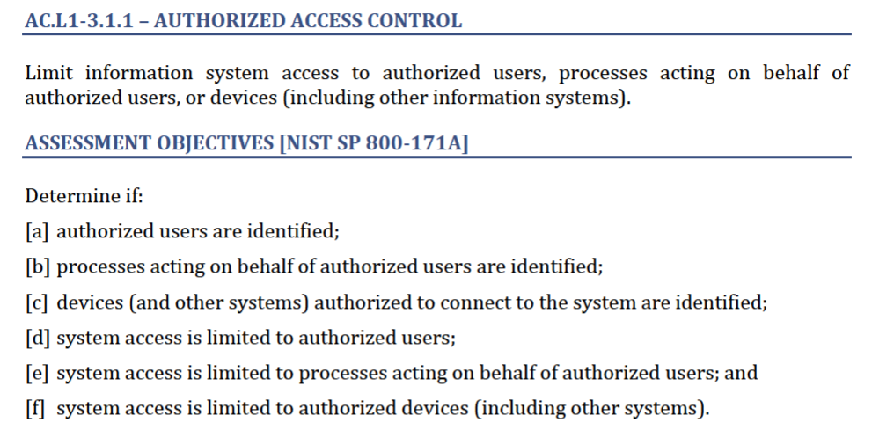
Practice and Self-Assessment Objectives Example
Source: Cybersecurity Maturity Model Certification Model Overview Version 2.0 | December 2021, https://dodcio.defense.gov/Portals/0/Documents/CMMC/AG_Level1_V2.0_FinalDraft_20211210_508.pdf

Slide 21
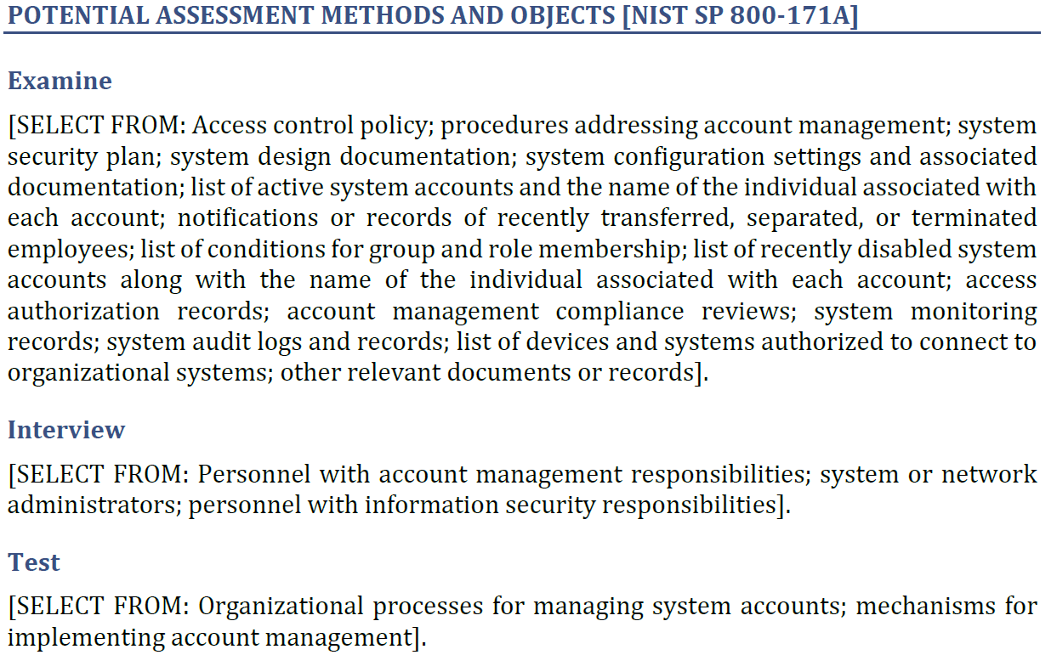
Potential Self-Assessment Methods and Objects for Practice Example
Potential
Objects
Source: Cybersecurity Maturity Model Certification Model Overview Version 2.0 | December 2021, https://dodcio.defense.gov/Portals/0/Documents/CMMC/AG_Level1_V2.0_FinalDraft_20211210_508.pdf

Slide 22
CMMC Practice Interconnectivity
The practices in CMMC are interconnected and work together to help provide good cyber hygiene. For example:
CMMC Practice AC.L1-3.1.1, controls system access based on user, process or device identity
CMMC Practice IA.L1-3.5.1, identifies information system users, processes acting on behalf of users, or devices
AC.L1-3.1.1 leverages IA.L1-3.5.1 which provides a vetted and trusted identity for access control required by AC.L1-3.1.1.
Notes:
The practices in CMMC are interconnected and work together to help provide good cyber hygiene. For example, CMMC practice AC.L1-3.1.1: Limit information system access to authorized users, processes acting on behalf of authorized users, or devices (including other information systems) controls system access based on user, process or device identity. AC.L1-3.1.1 leverages IA.L1-3.5.1 (Identify information system users, processes acting on behalf of users, or devices) which provides a vetted and trusted identity for access control required by AC.L1-3.1.1.

Slide 23

How to Prepare for CMMC Level 1
Recommendations prior to contract award:
Understand contract requirements: FAR 52.204-21, FCI and other applicable clauses and standards (Module 2)
Be aware of contractual reporting requirements (Module 3)
Keep performing cybersecurity best practices (Module 4)
Perform your self-assessment: CMMC Self-Assessment Level 1 Guide and CMMC Level 1 practices (Module 2)
Submit self-assessment per DoD guidance TBD
Understand subcontractor compliance requirements and keep up to date with regulatory changes
This Photo by Unknown Author is licensed under CC BY-SA-NC
Recommendations for after contract award:
Keep self-assessment score up to date (annually)
Monitor any changes to your environment
Follow and maintain reporting requirements
Be aware of flow down requirements for subcontractors
Notes:
Examine each of the CMMC Level 1 practices to determine
IT configuration requirements
Any additional software or hardware required
Note: The complexity of the company IT system may determine whether additional software or tools are required.
Determine which CMMC practices can readily be accomplished by in-house IT personnel and which require additional research or assistance
Develop a plan of action and milestones to implement the CMMC practices
Any subcontractor that is going to process, store or transmit FCI, needs to be CMMC level 1 certified
Unless a higher level is specified, all suppliers & sub-contractors must meet CMMC Level 1
Contractor CMMC Levels are identified in the Contract RFP
If your company is level 1 and only has FCI and not CUI, then they won't have to comply with DFARS 252.204-7012, unless the 7012 clause is in your contract and then you will need to know for awareness.
Ensure your suppliers who handle FCI are informed of CMMC and that they are also addressing any outstanding flow down FAR 52.204-21 requirements
Keep up to date with regulatory changes and updates -Communicate with all contract stakeholders
Level 1, CMMC Self-Assessment Guide: https://dodcio.defense.gov/Portals/0/Documents/CMMC/AG_Level1_V2.0_FinalDraft_20211210_508.pdf
Level 2, CMMC Assessment Guide: https://dodcio.defense.gov/Portals/0/Documents/CMMC/AG_Level2_MasterV2.0_FINAL_202112016_508.pdf
The CMMC Assessment Guides are organized into the following sections:
Assessment and Certification: provides an overview of the CMMC assessment and certification process, guidance around contractor size, and assessment scope.
Assessment Criteria and Methodology: provides guidance on the criteria and methodology (i.e. interview, examine, and test) Certified Assessors will employ during a CMMC assessment, as well as practice findings.
Practice Descriptions: provides the assessment requirements and specifics for each CMMC practice.
CMMC Level 1 Practices: https://ndisac.org/dibscc/cyberassist/cybersecurity-maturity-model-certification/level-1/
CMMC Level 2 Practices: https://ndisac.org/dibscc/cyberassist/cybersecurity-maturity-model-certification/level-2/
Recommendations for after contract award:
Primes must verify Tier 1 supply chain is certified to the correct CMMC Level before CUI data is shared
A DoD CMMC certification database is being created to assist in validation
Companies may need to be disqualified if they are not properly certified
Using sub-contractors that are not certified may be breach of contract

Slide 24
Module Summary
Understanding current and future regulatory requirements is imperative as a DoD supplier
Specialized information types, such as FCI and CUI, must be handled and protected according to applicable requirements
Understanding the CMMC model:
Breaking down parts of the model for further understanding
Providing steps to prepare for CMMC
For questions on the content, please send them to Contact Us - DIB SCC CyberAssist.
Next: Module 3 - Incident Reporting

