Slide 1

Defense Industrial Base (DIB)
Sector Coordinating Council (SCC)
Supply Chain Cyber Training
Cyber/Cybersecurity Maturity Model Certification (CMMC) v2.0

Slide 2
Agenda
Module 1: Cybersecurity: Why it is Important?
Module 2: Cybersecurity Maturity Model Certification
Module 3: Assessment Process - Interim
Module 4: Incident Reporting
Module 5: Cybersecurity Best Practices
Module 6: Risk Management
Resource Guide: Glossary, Acronym Guide and Resources for Additional Information
CMMC Domains
Survey

Slide 3
Assessment Process
Module 3

Slide 4
Disclaimer and Overview
Note: CMMC is still going through the rule-making process and certain aspects and requirements may change. Refer to the Resources Guide provided in this training for the most updated information.
The intent of this training is to build awareness for Defense Industrial Base (DIB) suppliers of the likely requirements of the Cybersecurity Maturity Model Certification (CMMC) and their obligation to meet FAR 52.204-21 (basic cyber hygiene) and DFARS 252.204-7012 (specialized data handling and protection requirements).
This training is self-paced and intended for a range of roles and responsibilities including, but not limited to, executives, project managers and technical staff from organizations seeking certification (OSC) and need to comply with CMMC. Currently, CMMC does not apply to any contractor.
Note: Completion of this training DOES NOT certify your organization. This training is intended for the purposes of providing awareness of the subjects outlined above.
The DIB Sector Coordinating Council (SCC) Supply Chain Task Force does not take responsibility for suppliers’ certification by the CMMC 3rd Party Assessment Organization (C3PAO).
This training focuses on U.S. regulations and industry best practices:
  U.S. Department of Defense (DoD) Chief Information Officer (CIO) Cybersecurity Maturity Model Certification (CMMC) Information
  National Institute of Standards & Technologies (NIST) publications
  National Archives & Records Administration (NARA) definitions
  DIB SCC Supply Chain Task Force – CyberAssist website

Slide 5
Module Topics and Objectives
Helpful Hint:
Refer to the Resource Guide for a Glossary and Acronym Guide
Topics covered in this module:
  CMMC Assessment Level Identification
  Anticipated CMMC Level 2 Assessment Process
  Pre-Regulation Assessment - Joint Surveillance
  Identify Assessment Scope
  Practice and Assessment Objective Review
  CMMC Certification Process
  How to Prepare for CMMC Level 2
The objectives of this module are:
  Provide understanding of the CMMC Level 2 assessment process;
  Provide understanding of the CMMC certification process; and
  Provide understanding of how to prepare for CMMC Level 2.
A legend has been provided to assist with determining the content that you will need to know for each of the CMMC levels and what is additional content that will assist your organization with your cybersecurity posture. The corresponding symbol will be located at the top left corner of the slide.
Content Legend
= CMMC L1 Content
= CMMC L2 Content
= CMMC L3 Content
= Non-CMMC Content/Extra

Slide 6
Acronyms & Definitions
Acronym | Full Name | Definition
C3PAO | CMMC Third Party Assessment Organization | An Entity that is certified to be contracted to and OSC to provide consultative advice OR certified assessments.
CAICO | CMMC Assessors and Instructors Certification Organization | The CAICO is the dedicated CMMC entity facilitating the training, examination, and professional certification for individuals within the CMMC Ecosystem. The CAICO is a wholly owned subsidiary of the CMMC Accreditation Body, Inc. and operates as a nonprofit organization with federal tax-exempt status.
CAP | CMMC Assessment Process | Provides procedures and guidance for CMMC C3PAOs conducting official CMMC Assessments of organizations seeking CMMC certification.
CCA | Certified CMMC Assessor | A person who has successfully completed all certification program requirements as outlined by the CAICO for becoming a Level 2 CMMC Assessor. A Provisional Assessor (PA) will become a CCP and then a CCA by passing the associated certification exam(s).
CCP | Certified CMMC Professional | A person who has successfully completed all certification program requirements as outlined by the CAICO for becoming a Level 1 CMMC Assessor.
CMMC | Cybersecurity Maturity Model Certification | Set of standards established by the DoD against which an OSC is to be assessed.
Source: https://cyberab.org/CMMC-Ecosystem/Terminology

Slide 7
Acronyms & Definitions (cont’d)
Acronym | Full Name | Definition
CUI | Controlled Unclassified Information | Information that requires safeguarding or dissemination control pursuant to and consistent with laws, regulations, and government-wide policies, excluding information that is classified under Executive Order 13526, Classified National Security Information, December 29, 2009, or any predecessor or successor order, or Atomic Energy Act of 1954, as amended. Source: NIST SP800-171 Rev 2
The Cyber AB | The Cyber Accreditation Body (formerly CMMC Accreditation Body) | The Cyber AB is the official accreditation body of the Cybersecurity Maturity Model Certification (CMMC) Ecosystem and the sole authorized non-governmental partner of the U.S. Department of Defense in implementing and overseeing the CMMC conformance regime.
DCMA | Defense Contract Management Agency | Agency that provides contract administration services for the Department of Defense, other federal organizations and international partners, and is an essential part of the acquisition process from pre-award to sustainment. (DCMA.mil)
DFARS | Defense Federal Acquisition Regulation Supplement | The DFARS provides DoD implementation and supplementation of the Federal Acquisition Regulation (FAR). The DFARS contains requirements of law, DoD-wide policies, delegations of FAR authorities, deviations from FAR requirements, and policies/procedures that have a significant effect on the public. (osd.mil)
Cyber/CMMC Training
Source: https://cyberab.org/CMMC-Ecosystem/Terminology

Slide 8
Acronyms & Definitions (cont’d)
Acronym | Full Name | Definition
DIBCAC | Defense Industrial Base Cyber Assessment Center | Leads the Department of Defense's (DoD) contractor cybersecurity risk mitigation efforts. DIBCAC assesses DoD contractors' compliance with the Defense Federal Acquisition Regulation Supplement (DFARS) clause 252.204-7012 and the National Institute of Standards and Technology (NIST) Special Publication (SP) 800-171 as well as, the DFARS clause 252.204-7020, NIST SP 800-171 DoD Assessment Requirements. (DCMA.mil)
FAR | Federal Acquisition Regulation | The Federal Acquisition Regulations System is established for the codification and publication of uniform policies and procedures for acquisition by all executive agencies. (acquisition.gov)
FCI | Federal Contract Information | Federal contract information means information, not intended for public release, that is provided by or generated for the Government under a contract to develop or deliver a product or service to the Government, but not including information provided by the Government to the public (such as on public Web sites) or simple transactional information, such as necessary to process payments. Source: 48 CFR § 52.204-21
OSC | Organization Seeking Certification | The Organization that is going through the CMMC assessment process to receive a level of Certification for a given environment.
Cyber/CMMC Training
Source: https://cyberab.org/CMMC-Ecosystem/Terminology

Slide 9
Acronyms & Definitions (cont’d)
Acronym | Full Name | Definition
POAM/POA&M | Plan(s) of Action and Milestones | A document that identifies tasks that need to be accomplished. It details resources required to accomplish the elements of the plan, milestones for meeting the tasks, and the scheduled completion dates for the milestones. (nist.gov)
RP | Registered Practitioner | Professionals who provide CMMC implementation consultative services.
RPO | Registered Provider Organization | An organization authorized to represent itself as familiar with the basic constructs of the CMMC Standard, with a CMMC-AB provided logo, to deliver non-certified CMMC Consulting Services. Signifies that the organization has agreed to the CMMC-AB Code of Professional Conduct.
SPRS | Supplier Performance Risk System | The authoritative source to retrieve supplier and product PI (performance information) assessments for the DoD acquisition community to use in identifying, assessing, and monitoring unclassified performance.” (DoDI 5000.79)
Cyber/CMMC Training
Source: https://cyberab.org/CMMC-Ecosystem/Terminology

Slide 10
Assessment Level Identification
When CMMC “goes live,” organizations will need to determine the appropriate assessment path and level, given the type of information they have access to or develop
  Federal Contract Information (FCI) only
    Self-assessment of CMMC Level 1 (L1) practices using the CMMC Self-Assessment Guide - Level 1 for additional guidance
  Controlled Unclassified Information (CUI) identified as Non-critical to national security *
    Self-assessment of CMMC L2 practices using the CMMC L2 Assessment Guide
  CUI identified as Critical to national security *
    Requires certification by an authorized C3PAO from the Cyber AB Marketplace
  CUI identified as requiring enhanced protections*
    Requires CMMC L3 certification by DCMA DIBCAC*
*Note: CMMC is still going through the rule-making process and certain aspects and requirements of this clause may change. Refer to the Resources Guide provided in this training for the most updated information.

Slide 11
Anticipated CMMC L2 Assessment Process
Pre-assessment
  Identify assessment boundary at OSC
  Self-assess CMMC L2 and remediate any findings or gaps
    Optional: Hire RPO to perform assessment and recommend remediations
Once all practices are sufficiently and adequately documented and performed
  Identify authorized C3PAO through the Cyber AB Marketplace
  Contract with C3PAO
  Identify assets and scoping boundary to be assessed
  Schedule and perform assessment by C3PAO
Post assessment
  Receive assessment results
    No gaps, receive CMMC L2 Certification
    Gaps found, remediate and request reassessment
  Keep documentation and boundary scope assets updated to meet CMMC L2 practices during 3-year certification period

Slide 12
Pre-Regulation Assessment – Joint Surveillance
Prior to release of updated regulation, the DoD is recommending companies volunteer for the Joint Surveillance program
The Joint Surveillance program pairs an OSC-selected authorized C3PAO with DCMA DIBCAC for the OSC’s assessment
  Acceptance into Joint Surveillance program will be scheduled based on DCMA availability and prioritization
C3PAO leads the assessment with oversight by DCMA DIBCAC
Upon completion, OSC receives updated DIBCAC High score in SPRS

Slide 13
Joint Surveillance Program – C3PAO/DCMA DIBCAC Assessment
Step 1: OSC identifies Assessment Scope Boundaries
Step 2: OSC contracts with an authorized C3PAO from the Cyber AB Marketplace
Step 3: C3PAO coordinates with DCMA DIBCAC and Cyber AB to identify possible scheduling dates
Step 4: Once dates and assessment scope are agreed upon by all parties
  OSC gathers artifacts and securely shares with C3PAO and DIBCAC
  C3PAO and DIBCAC perform readiness review of provided artifacts (virtual)
  Once virtual review is complete, the OSC, C3PAO and DIBCAC will perform on-site assessment(s) at one or more previously agreed upon locations of the OSC
    OSC’s primary business location will typically be the meeting site
    Secondary sites may include data center(s) and/or manufacturing site(s) but must be agreed upon and scheduled by all parties
Step 5: After the assessment
  DCMA DIBCAC/C3PAO will upload the OSC scores to SPRS
  SPRS score is valid for 3 years; however, senior leadership certification is required yearly
  OSC may need to work POAMs and perform re-evaluation at a future date

Slide 14
Identify Assessment Scope
Prior to conducting assessment, the scope needs to be identified, CMMC Assessment Scope Level 2
Assets that are included in the CMMC Assessment Scope and are assessed against CMMC practices:
  CUI Assets -assets that process, store and transmit CUI
  Security Protection Assets - assets that provide security functions or capabilities to the contractor’s CMMC Assessment Scope, irrespective of whether or not these assets process, store, or transmit CUI
Assets that are part of the Assessment Scope but not CMMC Practices and MUST show that these assets are managed using the contractor’s risk-based security policies, procedures and practices
  Contractor Risk Managed Assets - Assets that can, but are not intended to, process, store, or transmit CUI because of security policy, procedures, and practices in place
  Specialized Assets – Assets that may or may not process, store, or transmit CUI, e.g., government property, Internet of Things (IoT) devices
Source: CMMC Assessment Guide – Level 2, https://dodcio.defense.gov/Portals/0/Documents/CMMC/Scope_Level2_V2.0_FINAL_20211202_508.pdf
Notes:
CMMC Assessment Scope – Level 2 Guide, https://dodcio.defense.gov/Portals/0/Documents/CMMC/Scope_Level2_V2.0_FINAL_20211202_508.pdf
CUI Assets:
Process - CUI can be used by an asset (e.g., accessed, entered, edited, generated, manipulated, or printed).
Store - CUI is inactive or at rest (e.g., located on electronic media, in system component memory, or in physical format such as paper documents).
Transmit - CUI is being transferred from one asset to another asset (e.g., data in transit using physical or digital transport methods).
CUI Assets are part of the CMMC Assessment Scope and are assessed against applicable CMMC practices.
Out-of-Scope Assets do not process, store, or transmit CUI. Out-of-Scope Assets are outside of the CMMC Assessment Scope and should not be part of the CMMC assessment.
Security Protection Assets: Assets that provide security functions or capabilities to the Contractor’s CMMC Assessment Scope, irrespective of whether or not these assets process, store, or transmit CUI.
People - Employees, contractors, vendors, and external service provider personnel
Technology - Servers, client computers, mobile devices, network appliances (e.g., firewalls, switches, APs, and routers), VoIP devices, applications virtual machines, and database systems
Facilities - Physical office locations, satellite offices, server rooms, datacenters, manufacturing plants and secure rooms
External Service Provider (ESP) - External people, technology, or facilities that the organization uses, including cloud services, co-located data centers, hosting providers, and managed security service providers.
Source: CMMC Assessment Scope - Level 2, Version 2.0, December 2021

Slide 15
Identify Assessment Scope (cont’d)
Assets that are Out-of-Scope of the Assessment
  Out-of-Scope Assets – Assets that cannot process, store, or transmit CUI and are physically or logically separated.
For all assets, the contractor is required to:
  Document these assets in asset inventory;
  Document these assets in System Security Plan (SSP); and
  Provide a network diagram of the assessment scope (to include these assets) to facilitate scoping discussions during the pre-assessment.
Identifying Security Protection Assets is a critical part of scoping a CMMC engagement. (People, technology, facilities)
Source: CMMC Assessment Guide – Level 2, https://dodcio.defense.gov/Portals/0/Documents/CMMC/Scope_Level2_V2.0_FINAL_20211202_508.pdf
Notes:
CMMC Assessment Scope – Level 2 Guide, https://dodcio.defense.gov/Portals/0/Documents/CMMC/Scope_Level2_V2.0_FINAL_20211202_508.pdf
CUI Assets:
Process - CUI can be used by an asset (e.g., accessed, entered, edited, generated, manipulated, or printed).
Store - CUI is inactive or at rest (e.g., located on electronic media, in system component memory, or in physical format such as paper documents).
Transmit - CUI is being transferred from one asset to another asset (e.g., data in transit using physical or digital transport methods).
CUI Assets are part of the CMMC Assessment Scope and are assessed against applicable CMMC practices.
Out-of-Scope Assets do not process, store, or transmit CUI. Out-of-Scope Assets are outside of the CMMC Assessment Scope and should not be part of the CMMC assessment.
Security Protection Assets: Assets that provide security functions or capabilities to the Contractor’s CMMC Assessment Scope, irrespective of whether or not these assets process, store, or transmit CUI.
People - Employees, contractors, vendors, and external service provider personnel
Technology - Servers, client computers, mobile devices, network appliances (e.g., firewalls, switches, APs, and routers), VoIP devices, applications virtual machines, and database systems
Facilities - Physical office locations, satellite offices, server rooms, datacenters, manufacturing plants and secure rooms
External Service Provider (ESP) - External people, technology, or facilities that the organization uses, including cloud services, co-located data centers, hosting providers, and managed security service providers.
Source: CMMC Assessment Scope - Level 2, Version 2.0, December 2021

Slide 16
Practice and Assessment Objective Review
Organizations should become familiar with the CMMC Assessment Guide Level 2, and the Assessment Objectives associated with each practice
Each practice and associated assessment objectives will likely necessitate the use of at least two of the three assessment methods (examine, interview, test) to validate the adequacy (the right evidence) and sufficiency (enough of the right evidence) of each practice and associated assessment objectives.
  Assessment Objectives identify the specific list of objectives that must be satisfied to receive a rating of MET for the practice or process, which means your company has completed the objectives for that practice or process
Source: CMMC Assessment Guide – Level 2, https://dodcio.defense.gov/Portals/0/Documents/CMMC/Scope_Level2_V2.0_FINAL_20211202_508.pdf
Notes:
DoD contracts that specify the need for a contractor to process, store, or transmit CUI require the company to comply with CMMC Level 2 practices.
Who is Interviewed
The Certified Assessor has discussions with contractor staff to understand if a practice has been addressed. Interviews of applicable staff (possibly at different organizational levels) determine if CMMC practices are implemented as well as if adequate resourcing, training, and planning have occurred for individuals to perform the practices.
What is Examined
Examination includes reviewing, inspecting, observing, studying, or analyzing assessment objects. The objects can be documents, mechanisms, or activities. For some practices, the Certified Assessor reviews documentation to determine if assessment objectives are met. Interviews with contractor staff may identify the documents the contractor uses. Documents need to be in their final forms; working papers (e.g., drafts) of documentation are not eligible to be submitted as evidence because they are not yet official and are still subject to change. Common types of documents that can be used as evidence include:
policy, process, and procedure documents;
training materials;
plans and planning documents; and
system-level, network, and data flow diagrams.
This list of documents is not exhaustive or prescriptive. A contractor may not have these specific documents, and other documents may be used to provide evidence of compliance. In other cases, the practice is best assessed by observing that safeguards are in place by viewing hardware, associated configuration information, or observing staff following a process.
What is Tested
Testing is an important part of the assessment process. Interviews tell the Certified Assessor what the contractor staff believe to be true, documentation provides evidence of intent, and testing demonstrates what has or has not been done. For example, contractor staff may talk about how users are identified, documentation may provide details on how users are identified, but seeing a demonstration of identifying users provides evidence that the practice is met. The Certified Assessor will determine which practices or objectives within a practice need demonstration or testing. Not all practices will require testing. Source: CMMC Assessment Guide, Level 2, Version 2.0, December 2021
The three possible assessment methods (Examine, Interview, and Test) and scoring evidence successfully for each practice
Assessment findings
MET - The contractor successfully meets the practice. For each practice marked MET, the certified assessor includes statements that indicate the
response conforms to all objectives and documents the appropriate evidence to support the response.
NOT MET - The contractor has not met the practice. For each practice marked NOT MET, the certified assessor includes statements that explain why
and documents the appropriate evidence that the contractor does not conform fully to all of the objectives.
NOT APPLICABLE (N/A) - The practice does not apply for the assessment. For each practice marked N/A, the certified assessor includes a statement that explains
why the practice does not apply to the contractor. For example, SC.L1-3.13.5 might be N/A if there are no publicly accessible systems.
A contractor can inherit practice objectives. A practice objective that is inherited is MET if adequate evidence is provided that the enterprise or
another entity such as an External Service Provider (ESP), performs the practice objective. An ESP may be external people, technology, or facilities
that the contractor uses, including cloud service providers, managed service providers, managed security providers, cybersecurity-as-a-service
providers.
Evidence from the enterprise or entity from with the objectives are inherited should show they applicable to in-scope assets and that the assessment
objectives are met. For each practice objective that is inherited, the certified assessor includes statements that indicate how they were evaluated and
from whom they are inherited. If the contractor cannot demonstrate adequate evidence for all assessment objectives, through either contractor
evidence or evidence of inheritance, the contractor will receive a NOT MET for the practice. Source: CMMC Assessment Process (CAP), Version 1.0, July 2022

Slide 17
Practice and Assessment Objective Review (cont’d)
  Assessment Methods define the nature and the extent of the assessor’s actions –
    Examine (Artifact)
    Interview (Observation/Affirmation)
    Test (Demonstrate)
  Assessment Objects identify the specific items being assessed and can include specifications, mechanisms, activities, and individuals
Assessment of CMMC practice results in one of three possible findings:
  MET
  NOT MET
  NOT APPLICABLE
All Level 2 practices will need a finding of MET or NOT APPLICABLE, to demonstrate CMMC Level 2 compliance
Source: CMMC Assessment Guide – Level 2, https://dodcio.defense.gov/Portals/0/Documents/CMMC/Scope_Level2_V2.0_FINAL_20211202_508.pdf
Notes:
DoD contracts that specify the need for a contractor to process, store, or transmit CUI require the company to comply with CMMC Level 2 practices.
Who is Interviewed
The Certified Assessor has discussions with contractor staff to understand if a practice has been addressed. Interviews of applicable staff (possibly at different organizational levels) determine if CMMC practices are implemented as well as if adequate resourcing, training, and planning have occurred for individuals to perform the practices.
What is Examined
Examination includes reviewing, inspecting, observing, studying, or analyzing assessment objects. The objects can be documents, mechanisms, or activities. For some practices, the Certified Assessor reviews documentation to determine if assessment objectives are met. Interviews with contractor staff may identify the documents the contractor uses. Documents need to be in their final forms; working papers (e.g., drafts) of documentation are not eligible to be submitted as evidence because they are not yet official and are still subject to change. Common types of documents that can be used as evidence include:
policy, process, and procedure documents;
training materials;
plans and planning documents; and
system-level, network, and data flow diagrams.
This list of documents is not exhaustive or prescriptive. A contractor may not have these specific documents, and other documents may be used to provide evidence of compliance. In other cases, the practice is best assessed by observing that safeguards are in place by viewing hardware, associated configuration information, or observing staff following a process.
What is Tested
Testing is an important part of the assessment process. Interviews tell the Certified Assessor what the contractor staff believe to be true, documentation provides evidence of intent, and testing demonstrates what has or has not been done. For example, contractor staff may talk about how users are identified, documentation may provide details on how users are identified, but seeing a demonstration of identifying users provides evidence that the practice is met. The Certified Assessor will determine which practices or objectives within a practice need demonstration or testing. Not all practices will require testing. Source: CMMC Assessment Guide, Level 2, Version 2.0, December 2021
The three possible assessment methods (Examine, Interview, and Test) and scoring evidence successfully for each practice
Assessment findings
MET - The contractor successfully meets the practice. For each practice marked MET, the certified assessor includes statements that indicate the
response conforms to all objectives and documents the appropriate evidence to support the response.
NOT MET - The contractor has not met the practice. For each practice marked NOT MET, the certified assessor includes statements that explain why
and documents the appropriate evidence that the contractor does not conform fully to all of the objectives.
NOT APPLICABLE (N/A) - The practice does not apply for the assessment. For each practice marked N/A, the certified assessor includes a statement that explains
why the practice does not apply to the contractor. For example, SC.L1-3.13.5 might be N/A if there are no publicly accessible systems.
A contractor can inherit practice objectives. A practice objective that is inherited is MET if adequate evidence is provided that the enterprise or
another entity such as an External Service Provider (ESP), performs the practice objective. An ESP may be external people, technology, or facilities
that the contractor uses, including cloud service providers, managed service providers, managed security providers, cybersecurity-as-a-service
providers.
Evidence from the enterprise or entity from with the objectives are inherited should show they applicable to in-scope assets and that the assessment
objectives are met. For each practice objective that is inherited, the certified assessor includes statements that indicate how they were evaluated and
from whom they are inherited. If the contractor cannot demonstrate adequate evidence for all assessment objectives, through either contractor
evidence or evidence of inheritance, the contractor will receive a NOT MET for the practice. Source: CMMC Assessment Process (CAP), Version 1.0, July 2022

Slide 18
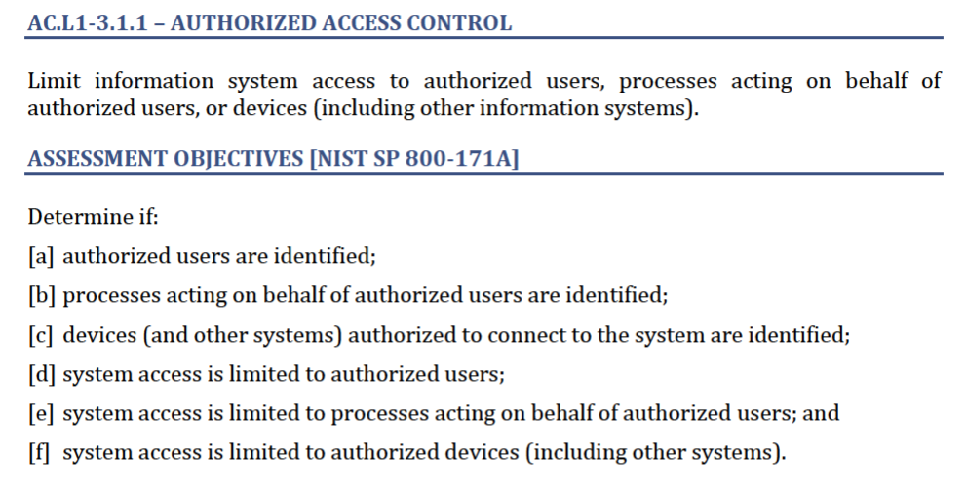
Practice and Assessment Objectives Example
Look for Key Words to determine what is needed to be done or gathered
Source: CMMC Assessment Guide – Level 2, https://dodcio.defense.gov/Portals/0/Documents/CMMC/Scope_Level2_V2.0_FINAL_20211202_508.pdf
Notes:
The words “defined”, “identified”, or “specified” indicate requirements that must be explained in the SSP and be included in documentation such as policy, procedures, etc.
Words such as “authorized”, “created”, “enforced”, “implemented”, or “limited” indicate that evidence must be provided by the OSC to show proof of meeting the assessment objective(s).

Slide 19
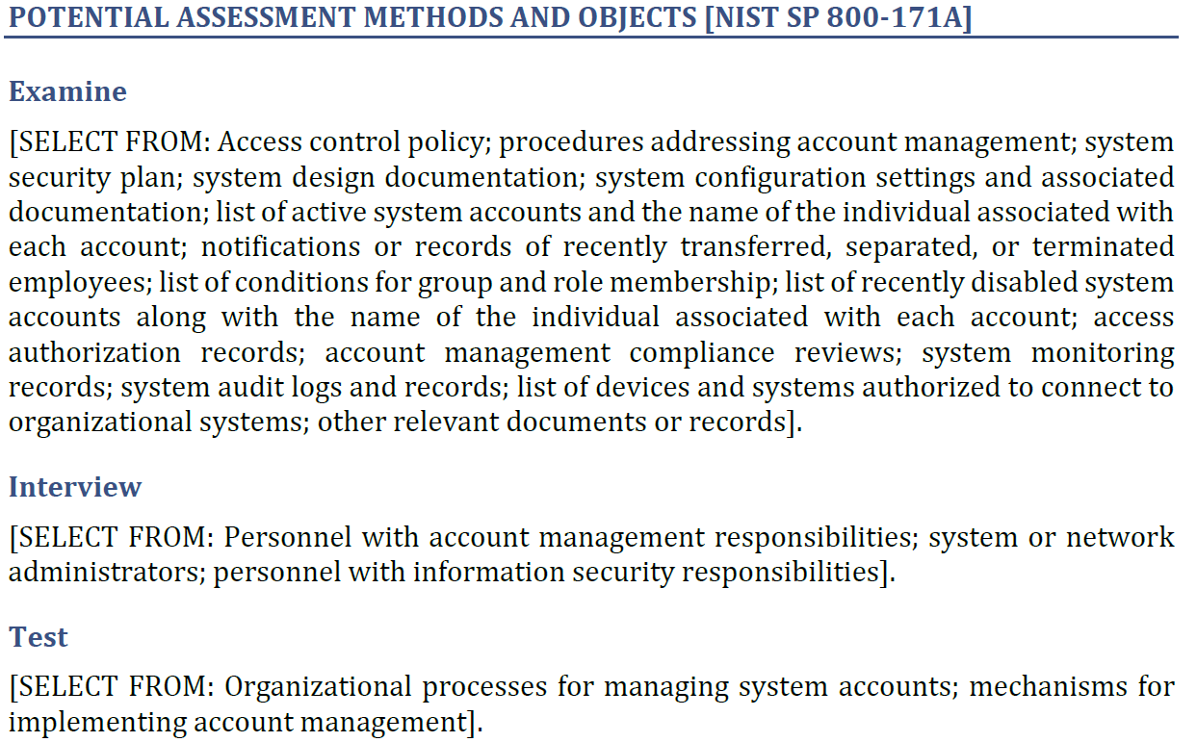
Potential Assessment Methods and Objects for Practice Example
Potential
Objects
Source: CMMC Assessment Guide – Level 2, https://dodcio.defense.gov/Portals/0/Documents/CMMC/Scope_Level2_V2.0_FINAL_20211202_508.pdf

Slide 20
CMMC Certification Process
Cyber AB, https://cyberab.org/
The Cyber AB Marketplace is the ONLY authorized resource to assist in training, RPO, and C3PAO services
The Cyber AB will provide information and set requirements for prospective CMMC C3PAOs and individual assessors.
*Note: CMMC is still going through the rule-making process and certain aspects and requirements of this clause may change. Refer to the Resources Guide provided in this training for the most updated information.
Notes:
The CMMC AB Marketplace, https://cyberab.org/Catalog#!/c/s/Results/Format/list/Page/1/Size/9/Sort/NameAscending, for authorized resources to assist in training, RPO and CMMC Third-Party Assessment Organization (C3PAO) services.

Slide 21

How to Prepare for CMMC Level 2
Recommendations prior to contract award:
Understand contract requirements: FAR 52.204-21, CMMC requirements, CUI and other applicable clauses and standards, and CMMC requirements (Module 2)
Be aware of contractual reporting requirements (Module 4)
Identify possible data types and locations, access, and security
Keep following cybersecurity best practices (Module 5)
Perform your self-assessment
Update SPRS self-assessment yearly
Engage C3PAO for certification (for critical national security systems)
Understand subcontractor compliance requirements and keep up to date with regulatory changes
This Photo by Unknown Author is licensed under CC BY-SA-NC
Recommendations for after contract award:
Keep self-assessment score up to date (annually)
Keep certification up to date
Monitor any changes to your environment
Follow and maintain reporting requirements
Be aware of flow down requirements for subcontractors, e.g., limit data flow down to only what is needed
Notes:
Examine each of the CMMC Level 2 practices to determine
IT configuration requirements
Any additional software or hardware required
Note: The complexity of the company IT system may determine whether additional software or tools are required.
Determine which CMMC practices can readily be accomplished by in-house IT personnel and which require additional research or assistance
Develop a plan of action and milestones to implement the CMMC practices
Any subcontractor that is going to process, store or transmit CUI, needs to be CMMC level 2 certified
Unless a higher level is specified, all suppliers & sub-contractors must meet CMMC Level 1
Contractor CMMC Levels are identified in the Contract RFP
Ensure your suppliers who handle FCI and CUI are informed of CMMC and that they are also addressing any outstanding flow down FAR 52.204-21 and CMMC requirements
Keep up to date with regulatory changes and updates -Communicate with all contract stakeholders
CMMC Level 1 Self-Assessment Guide: https://dodcio.defense.gov/Portals/0/Documents/CMMC/AG_Level1_V2.0_FinalDraft_20211210_508.pdf
CMMC Level 2 Assessment Guide: https://dodcio.defense.gov/Portals/0/Documents/CMMC/AG_Level2_MasterV2.0_FINAL_202112016_508.pdf
The CMMC Assessment Guides are organized into the following sections:
Assessment and Certification: provides an overview of the CMMC assessment and certification process, guidance around contractor size, and assessment scope.
Assessment Criteria and Methodology: provides guidance on the criteria and methodology (i.e. interview, examine, and test) Certified Assessors will employ during a CMMC assessment, as well as practice findings.
Practice Descriptions: provides the assessment requirements and specifics for each CMMC practice.
CMMC Level 1 Practices: https://ndisac.org/dibscc/cyberassist/cybersecurity-maturity-model-certification/level-1/
CMMC Level 2 Practices: https://ndisac.org/dibscc/cyberassist/cybersecurity-maturity-model-certification/level-2/
Recommendations for after contract award:
Primes must verify Tier 1 supply chain is certified to the correct CMMC Level before CUI data is shared
Companies may need to be disqualified if they are not properly certified
Using sub-contractors that are not certified may be breach of contract

Slide 22
Module Summary
Understanding the CMMC assessment process:
  Identifying the assessment scope
  Understanding the four phases of the CMMC assessment process
For questions on the content, please send them to Contact Us - DIB SCC CyberAssist.
Next: Module 4 – Incident Reporting

