Slide 1
Defense Industrial Base (DIB) Sector Coordinating Council (SCC) Supply Chain Cyber Training
Cyber/Cybersecurity Maturity Model Certification (CMMC) v2.0

Slide 2
Agenda
Module 1: Cybersecurity: Why it is Important?
Module 2: Cybersecurity Maturity Model Certification
Module 3: Incident Reporting
Module 4: Cybersecurity Best Practices
Resource Guide: Glossary, Acronym Guide and Resources for Additional Information
CMMC Domains
Survey

Slide 3
Cybersecurity: Why is it Important?
Module 1

Slide 4
Disclaimer and Overview
Note: CMMC is still going through the rule-making process and certain aspects and requirements may change. Refer to the Resources Guide provided in this training for the most updated information.
The intent of this training is to build awareness for Defense Industrial Base (DIB) suppliers of the likely requirements of the Cybersecurity Maturity Model Certification (CMMC) and their obligation to meet FAR 52.204-21 (basic cyber hygiene) and DFARS 252.204-7012 (specialized data handling and protection requirements).
This training is self-paced and intended for a range of roles and responsibilities including, but not limited to, executives, project managers and technical staff from organizations seeking certification (OSC) and need to comply with CMMC. Currently, CMMC does not apply to any contractor.
Note: Completion of this training DOES NOT certify your organization. This training is intended for the purposes of providing awareness of the subjects outlined above.
The DIB Sector Coordinating Council (SCC) Supply Chain Task Force does not take responsibility for suppliers’ certification by the CMMC 3rd Party Assessment Organization (C3PAO).
This training focuses on U.S. regulations and industry best practices:
U.S. Department of Defense (DoD) Chief Information Officer (CIO) Cybersecurity Maturity Model Certification (CMMC) Information
National Institute of Standards & Technologies (NIST) publications
National Archives & Records Administration (NARA) definitions
DIB SCC Supply Chain Task Force – CyberAssist website

Slide 5
Module Topics and Objectives
Helpful Hint:
Refer to the Resource Guide for a Glossary and Acronym Guide
Topics covered in this module:
What is Cybersecurity?
CIA Triad
Why it is important?
Are your IT environments protected? Is your information protected?
Module Summary
The objectives of this module are:
Provide understanding of the importance of cybersecurity;
Provide understanding of the CIA Triad; and
Provide understanding of who is at risk.
A legend has been provided to assist with determining the content that you will need to know for each of the CMMC levels and what is additional content that will assist your organization with your cybersecurity posture. The corresponding symbol will be located at the top left corner of the slide.
Content Legend
= CMMC L1 Content
= CMMC L2 Content
= CMMC L3 Content
= Non-CMMC Content/Extra

Slide 6
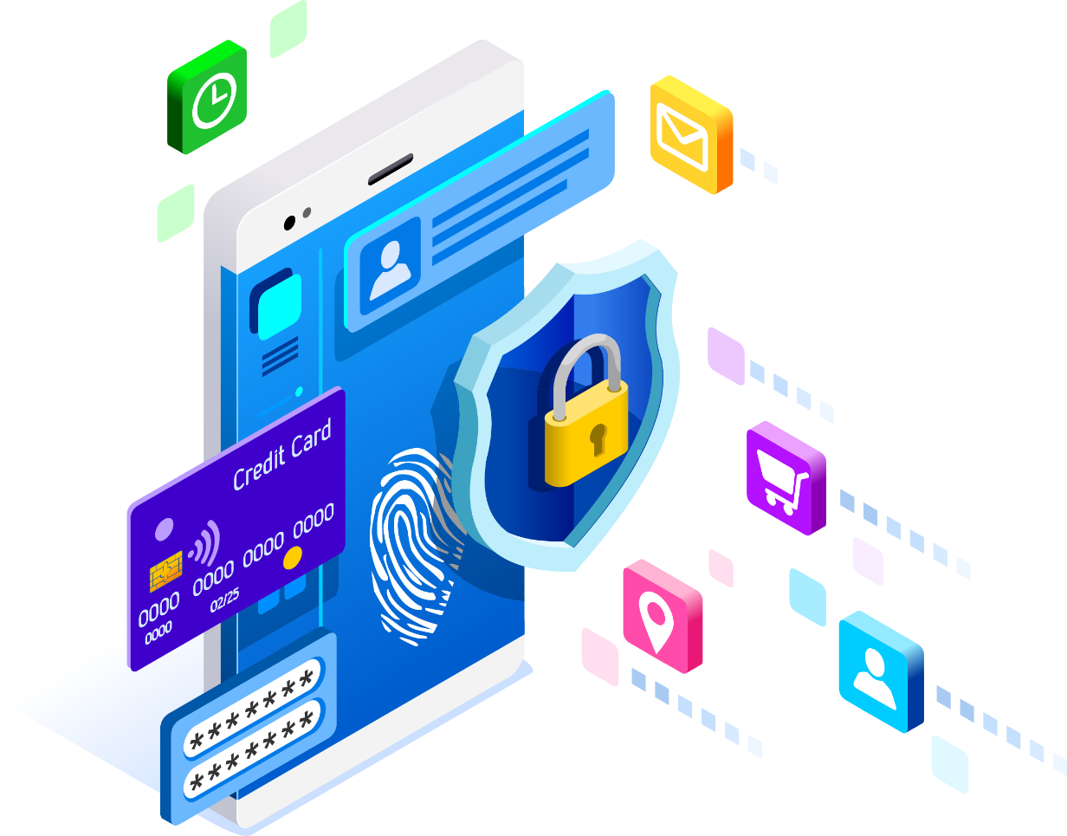
What is Cybersecurity?
All the tools we use and actions we take to keep computers, networks, and information safe and available for those who need it, and unavailable for those who should not have it.
That means protecting hardware, software, people, and data from everything from cyber attacks to earthquakes.
Cybersecurity is about keeping our information technology (IT) resources secure (confidential, available, and unaltered).
Notes:
Cybersecurity: Prevention of damage to, protection of, and restoration of computers, electronic communications systems, electronic communications services, wire communication, and electronic communication, including information contained therein, to ensure its availability, integrity, authentication, confidentiality, and nonrepudiation. Source: NSPD-54/HSPD-23
Cybersecurity is about keeping our information technology resources secure (confidential, available, and unaltered).

Slide 7
CIA Triad
Confidentiality
Ensuring information is only made available to, or shared with, authorized individuals.
Integrity
Ensuring information is protected against unauthorized modification or destruction.
CONFIDENTIALITY
INTEGRITY
CIA
TRIAD
AVAILABILITY
Availability
Ensuring timely and reliable access to, and use of, information.
Notes:
Cyber-attacks are attacks against information systems
Objective of Threat Actors Impact:
Confidentiality: Preserving authorized restrictions on information access and disclosure, including means for protecting personal privacy and proprietary information. Source: 44 U.S. Code Sec 3542
Confidentiality (theft / exfiltration of data);
Integrity: The security objective that generates the requirement for protection against either intentional or accidental attempts to violate data integrity (the property that data has not been altered in an unauthorized manner) or system integrity (the quality that a system has when it performs its intended function in an unimpaired manner, free from unauthorized manipulation). Source: NIST SP 800-33
Integrity (reliability of data);
Integrity: E.g., Products could be impacted in terms of reliability
Availability: Ensuring timely and reliable access to and use of information. Timely, reliable access to data and information services for authorized users. Source: CNSSI 4009
Availability (ability to access data)
Availability: E.g., DDoS / Denial of Service attacks - Disruption of IT Systems

Slide 8
Why is it Important?
Evolving Threats
Increasing
Potential Impact
CONFIDENTIALITY
INTEGRITY
AVAILABILITY
Increasingly
Unstable Threats
ADVANCED PERSISTENT THREATS (APT)
HACKTIVISTS
ROGUE ACTORS
BROADBASED
& CRIMINAL
INSIDER
The Only Constant is Change
Cybersecurity attacks continue to increase in frequency and sophistication for the Aerospace and Defense industry
Notes:
Why do hackers love small business?
Hackers prey on the weak (small business is often less equipped)
Hackers love internal access (computers unattended, stealing credentials, insider threat)
Hackers love what small businesses have to offer (intellectual property)
Everyone is at risk.
Security breaches have increased by 11% since 2018 and 67% since 2014.
The average times to identify a breach in 2019 was 206 days.
Smaller organizations (1-250 employees) have the highest targeted malicious email rate at 1 in 323.
Supply chain attacks are up 78% in 2019.
Symantec research found that 43% of cyber attacks are lodged against small businesses.
The National Cyber Security Alliance found that 60% of small companies are unable to sustain their businesses more than six months after a cyber attack.

Slide 9
Are your IT environments protected? Is your information secure?
As a DIB Partner, now is the time to understand your cybersecurity posture so that you can make sound, risk‐based decisions about investing in cybersecurity protections.
Identify and secure information through cybersecurity best practices.
Understand and identify your risks and the types of cyber threats and vulnerabilities that affect your business.
By understanding the threats and vulnerabilities that affect your business, the business owners can make sound, risk-based decisions about investing in cybersecurity protection.

Slide 10
Module Summary
Cybersecurity is about keeping our digital data, systems, and activities secure (confidential, available, and unaltered)
Cybersecurity attacks continue to increase in frequency and sophistication for the Aerospace and Defense industry and supply chain
Everyone is at risk when it comes to cyber attacks, but small businesses are more likely targets because of perceived limited resources to protect the business and its infrastructure
For questions on the content, please send them to DIB SCC Cyber Training
Next: Module 2 - Cybersecurity Maturity Model Certification (Level 1)

