Slide 1
Defense Industrial Base (DIB) Sector Coordinating Council (SCC) Supply Chain Cyber Training
Note: CMMC is still going through the rule-making process and certain aspects and requirements may change. Refer to the Resources Guide provided in this training for the most updated information.
Cyber/Cybersecurity Maturity Model Certification (CMMC) v2.0
CMMC Proposed Rule 32 CFR 170 Supplemental Slides

Slide 2
Initial Summary of CMMC Proposed Rule 32 CFR 170
CMMC Program Rule Focus/Purpose: Formally establishing DCMA DIBCAC Role/Responsibilities and Cyber AB Ecosystem with High-Level Planning
Comments were due 26 Feb 2024 (Public Inspection 22 Dec, Officially in Federal Register 26 Dec 2023)
32 CFR 170 Defense Contracting | Title: Cybersecurity Maturity Model Certification (CMMC) Program
230+ pages, 70+ regulatory language (initial summary on regulatory language only; does not include supplement/discussion)
4 Subparts: i) General Info, ii) Govt Roles & Responsibilities, iii) CMMC Ecosystem, & iv) CMMC Key Elements
24 Subordinate Parts designated as 32 CFR 170.01 – 170.24 and Appendix A with URLs for Assessment and Scoping Guides
Not DFARS 252.204-7021 Cybersecurity Maturity Model Certification Requirements or DFARS implementation
Describes the DoD CMMC Program and establishes policy for FCI and CUI safeguarding & compliance
Standards as set forth in FAR 52.204-21 and NIST 800-171 Rev 2, and for CMMC Level 3 only select requirements from NIST 800-172/ODPs
Establishes Requirements for CMMC Self Assessments/Certifications for Organizations w/Company Affirmation & Scoping Criteria
Information on Scoring, POA&M Conditions, & Subcontractor Compliance
Of interest includes Joint Surveillance limited acceptance & process for FedRAMP Moderate Equivalency
Source: Cybersecurity Maturity Model Certification Model Certification Program, A Proposed Rule by Department of Defense | December 26, 2023, https://www.federalregister.gov/d/2023-27280

Slide 3
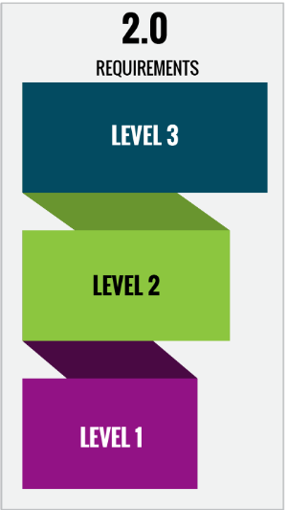
Initial Summary of CMMC Proposed Rule 32 CFR 170
CMMC Level 1 New or Partially New Requirements
Self-assessment using NIST SP 800-171A against “basic safeguarding” requirements of FAR clause 52.204-21 (15 FAR / 17 NIST SP 800-171 requirements) annually (Partially New)
Report implementation status in the DoD’s Supplier Performance Risk System (SPRS) (New)
Affirmation by organization senior official of continuing compliance with the security requirements annually (New)
CMMC
CMMC Level 2 New or Partially New Requirements
Requires affirmation after every assessment, including POAM closeout (New)
Requires affirmation annually by senior organization official (New)
Affirming official: OSA senior official who is responsible for ensuring OSA compliance with CMMC Program requirements
POAMs are allowed for selected requirements but must be closed out and verified (by 3rd party) within 180 days (New)
Has scoping specifics for different asset types (New)
Source: Cybersecurity Maturity Model Certification Model Certification Program, A Proposed Rule by Department of Defense | December 26, 2023, https://www.federalregister.gov/d/2023-27280
Image source: Cybersecurity Maturity Model Certification Model Overview Version 2.0 | December 2021, https://dodcio.defense.gov/Portals/0/Documents/CMMC/ModelOverview_V2.0_FINAL2_20211202_508.pdf

Slide 4
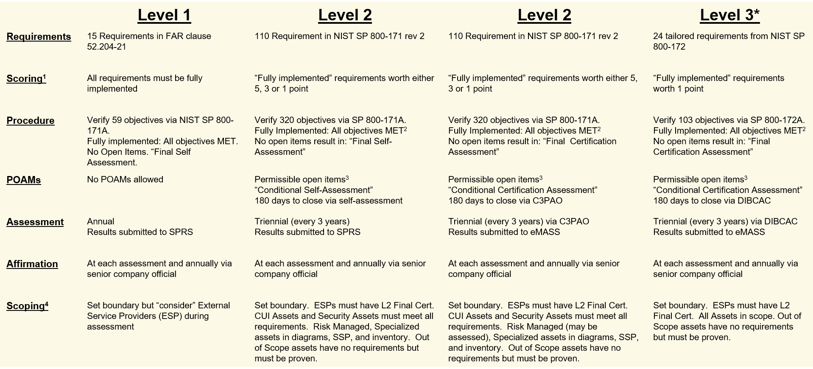
CMMC Proposed Rule Summary
Note: This slide has been recently updated due to an incorrectly cited source.
Self-Assessment
Certification Assessment
*Prerequisite: CMMC L2 Final Certification
See 170.24 for scoring details
See 170.16-170.18 for criteria
See 170.21 for restrictions
See 170.19
Primary source: Summit 7 Live Webinar, CMMC Published: A Comprehensive Overview of the Proposed CMMC Rule, Webinar: A Comprehensive Overview of the Proposed CMMC Rule (summit7.us), January 10, 2024
Supplemental source: Cybersecurity Maturity Model Certification Model Certification Program, A Proposed Rule by Department of Defense | December 26, 2023, https://www.federalregister.gov/d/2023-27280
Notes:
*Prerequisite: CMMC L2 Final Certification
See 170.24 for scoring details
See 170.16-170.18 for criteria
See 170.21 for restrictions
See 170.19

Slide 5
Proposed Timelines and Phases (170.3)
DoD “intends to include CMMC requirements for Levels 1, 2, and 3 in all solicitations issued on or after October 1, 2026, when warranted by any FCI or CUI information protection requirements”
Before Oct 1, 2026, DoD Program Managers will have discretion to include CMMC requirements
Phase 1
Immediately upon “the effective date of the DFARS rule that will implement CMMC Requirements”
Self-assessment only “when warranted by the FCI and CUI categories associated with the planned effort”
Phase 2
Six (6) months after start of Phase 1
In addition to Phase 1 requirements, DoD intends to include the CMMC Level 2 Certification Assessment requirement in all applicable DoD solicitations and contracts as a condition of contract award
Phase 3
One (1) Calendar Year after start of Phase 2
In addition to Phase 1 and 2 requirements, DoD intends to include the CMMC Level 2 Certification Assessment requirement in all applicable DoD solicitations and contracts as a condition of contract award and as a condition to exercise an option period on a contract awarded prior to the effective date
DoD intends to include the CMMC Level 3 Certification Assessment requirement in all applicable DoD solicitations and contracts as a condition of contract award
Phase 4
One (1) Calendar Year after start of Phase 2
All solicitations include CMMC requirements
Source: Cybersecurity Maturity Model Certification Model Certification Program, A Proposed Rule by Department of Defense | December 26, 2023, https://www.federalregister.gov/d/2023-27280

Slide 6
CMMC Proposed Rule 32 CFR 170 Resources
CMMC 32CFR Proposed Rule
Overview page: https://www.federalregister.gov/d/2023-27280
PDF: https://public-inspection.federalregister.gov/2023-27280.pdf
CMMC Guidance docs
Overview page: https://www.federalregister.gov/d/2023-27281
PDF: https://public-inspection.federalregister.gov/2023-27281.pdf
Department of Defense CMMC Proposed Rule Informational Video, February 2024, https://www.defense.gov/News/News-Stories/Article/Article/3678476/defense-department-releases-companion-video-for-cmmc-public-comment-period/

